Slide 1

COS 301
TEAM ANDROID - BRAVO

Slide 2
WHY ANDROID STUDIO?
Supports Gradle
Code Completion
User Interface
Drag-and-drop Interface

Slide 3
GRADLE
Build Tool used by Android Studio
Flexible and offers the best of Ant and Maven
Automated script when code is run
Creates a script for all modules in one file
Script can be changed as desired

Slide 4
GRADLE
Gradle built script for our Mock Interface
Specify type of application to build: “apply plugin: 'com.android.application‘”
This build script is divided into two parts:
Dependencies:
Other third party applications used for functionality
Ivy and Maven dependency and repository compatibility layer
Simple and flexible specification
Android:
It contains the fields “compileSdkVersion” and “buildToolsVersion”
It also contains the “defaultConfig” and “buildTypes” subsections.

Slide 5
GRADLE
defaultConfig Contents and Syntax:
defaultConfig {
applicationId "com.slugger7.upresearch"
minSdkVersion 16
targetSdkVersion 23
versionCode 1
versionName "1.0"
}

Slide 6
GRADLE
buildTypes Contents and Syntax:
buildTypes {
release {
minifyEnabled false
proguardFiles getDefaultProguardFile('proguard-android.txt'), 'proguard-rules.pro'
}
}

Slide 7
GRADLE
Dependencies:
dependencies {
compile fileTree(dir: 'libs', include: ['*.jar'])
testCompile 'junit:junit:4.12'
compile 'com.android.support:appcompat-v7:23.2.1'
compile 'com.android.support:design:23.2.1'
}

Slide 8
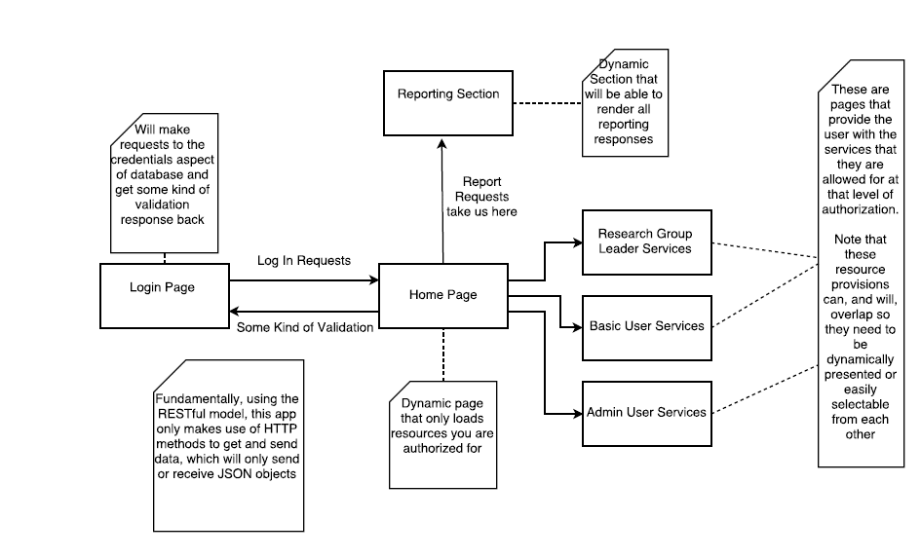
INTERFACE DESIGN FOR UP RESEARCH

Slide 9
INTERFACE DESIGN FOR UP RESEARCH
The homepage will be dynamically created for each user
Contents of the homepage will be papers in progress
On the homepage, there will be a sliding global menu
The menu will contain the following fields:
Basic User: Profile, Publication, Report, Search, Logout
Head of Research: an additional privileges field for such a user will be added
Admin: an additional privilege field named “Admin” will be added

Slide 10
INTERFACE DESIGN FOR UP RESEARCH
There will only be one global menu
This menu will be on the homepage
Each item on the menu will have a submenu
The submenu is depicted by three dots
These three dots will contain actions/subfields belonging to that item
These items on the submenu will then dynamically create a page
This page will display items related to that particular action

Slide 11
DATABASE
The will be a central server that will host the PostgreSQL database
This database is relational
The Android REST API will be used to access information on the database.
The information used will be stored as JSON objects

Slide 12
PROFILE
Each sub item selected will generate a page
The Profile dot menu will contain the following functions:
View/Edit Own Profile

Slide 13
PUBLICATION
The Publication dot menu will contain the following actions:
Add/Edit publications
View publications
Add/Edit publication type
Change publication state
Calculate accreditation points

Slide 14
REPORT
The reporting subsystem will render preexisting objects.
Each user has the ability to generate a report based on the level of privilege
The report will contain text-based data as well as a graph for statistical purposes

Slide 15
SEARCH
Users can search for other users to view their profiles
Theses users, however, cannot view the papers the users are working on
The profile information displayed is limited to the users demographical information and contact details

Slide 16
HEAD OF RESEARCH
The Head of Research is a user with added privileges
These privileges include:
Generating reports for the research group
Set up notifications
View profiles of users in the research group
Add publication
Edit publication state
Add user to a research group

Slide 17
ADMIN
The Admin has added privileges
These privileges include:

Slide 18
LOGOUT
This option will redirect the user to the login page
Once a user is logged out they cannot use the system
The system should log the session before logout
After a re-login, the session should resume

Slide 19
NOTIFICATIONS
We will enable notifications on paper objects
The notifications team will use the UP mail server to send out notification emails
The normal user cannot manipulate the notification settings in anyway

Slide 20
TECHNICAL CHALLENGES
These challenges include:
Session Management
Appropriate API for graphical Reporting Subsystem statistics generation
Password reset options
Update installations
Maintain history of activity for each user
Android API version should be selected to balance user reachability and functionality
Handling every possible exception thrown elegantly, i.e. to avoid the program to crash
Handling unreliable connections
Importing/Exporting CSV files

